Slide 1
Exploring Global Business

Slide 2
Learning Objectives
Explain the economic basis for international business.
Discuss the restrictions nations place on international trade, the objectives of these restrictions, and their results.
Outline the extent of international trade and the world economic outlook for trade.
Discuss international trade agreements and international economic organizations working to foster trade.
Define the methods by which a firm can organize for and enter into international markets.
Describe the various sources of export assistance.
Identify the institutions that help firms and nations finance international business.

Slide 3
International Business
International business encompasses all business activities that involve exchanges across national boundaries.
A business is engaged in international business when it buys some portion of its input from, or sells some portion of its output to, an organization located in a foreign country.

Slide 4
Business Opportunities
Advancement in technology and reduction of barriers to trade have made the individual economies interdependent
  Results in better communication with increased competition and shifting opportunities

Slide 5
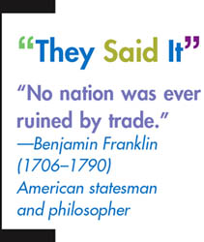
Why Nations Trade
Boosts economic growth by
  expanding markets
Reduces risk
  Global trade reduces dependence on one economy, lowering the risk for multinational firms
Inflow of innovation
  International trade offer companies source of new ideas
Access to factors of production
  Evens out resource imbalances among nations
  Access to more efficient production systems

Slide 6
Why Nations Trade
“The flattening of the world has presented us with new opportunities, new challenges, new partners but, also, alas new dangers, particularly as Americans it is imperative that we be the best global citizens that we can be—because in a flat world, if you don’t visit a bad neighborhood, it might visit you.”
The World Is Flat, Thomas L. Friedman (2005)
(NY Times Foreign Affairs Columnist)

Slide 7
Strategies for Reaching Global Markets
Importing
Exporting
Foreign Outsourcing
Contracting with foreign suppliers to produce products
Buying products domestically that have been produced or grown in foreign nations
Selling products in foreign nations that have been produced domestically

Slide 8
Organizing for
International Business
Licensing
Exporting
Joint-Venture
Totally Owned Facilities
Strategic Alliances
Trading Companies
Countertrade
Multinational Firm

Slide 9
International Trade
Importing
Buying products domestically that have been produced or grown in foreign nations
Exporting
Selling products in foreign nations that have been produced domestically
Notes:
TRADE AND MANUFACTURING
Vast productivity gains relating to increased use of automation and information technologies have helped U.S. manufacturers retain and in many areas enhance their global competitiveness in recent years, even as the number of Americans employed in manufacturing has declined since its peak in 1979.
U.S. exports of manufactured goods reached nearly $1.3 trillion in 2016, accounting for nearly 60% of all U.S. exports.
The U.S. Department of Commerce estimates that exports of manufactured goods directly support approximately 6 million U.S. factory jobs—roughly half of all manufacturing employment.
TRADE AND U.S. SERVICES
U.S. exports of services are also booming, reaching $750 billion in 2016 and achieving a trade surplus in services of $248 billion, according to the U.S. Department of Commerce.
The United States is by far the world’s largest exporter of services, and America’s globally competitive service industries—including audiovisual, banking, energy services, express delivery, information technology, insurance, and telecommunications—benefit immensely from opportunities abroad.
TRADE AND FARMING
American farmers and ranchers also depend on exports. The same is true for America’s farmers and ranchers. One in three acres on America’s farms is planted for exports.
For many crops, such as wheat or almonds, more than half is sold abroad. U.S. agriculture is so productive there’s no way Americans could consume this bounty alone.

Slide 10
International Trade
Importing
Buying products domestically that have been produced or grown in foreign nations
Exporting
Selling products in foreign nations that have been produced domestically
Notes:
BENEFITS OF IMPORTS
Amid a renewed focus on boosting U.S. exports, it is important to bear in mind that imports benefit Americans as well. They bring lower prices and more choices for American families as they try to stretch their budgets. Companies also depend on imports for raw materials and competitively priced inputs.
Imports give us access to products that would not otherwise be available—such as fresh fruit in the winter. Access to imports boosts the purchasing power of the average American household by about $18,000 annually.
Companies’ imports of intermediate goods, raw materials, and capital goods account for more than 60% of all U.S. goods imports—lowering costs for manufacturers and other businesses and helping them hone their competitive edge.

Slide 11
Why Nations Trade
“Trade is an important source of good jobs for our workers and a source of higher growth for our economy.”
“In our lifetime, trade has helped lift millions of people and whole nations out of poverty and put them on the path of prosperity.”
President George W. Bush (2002)

Slide 12
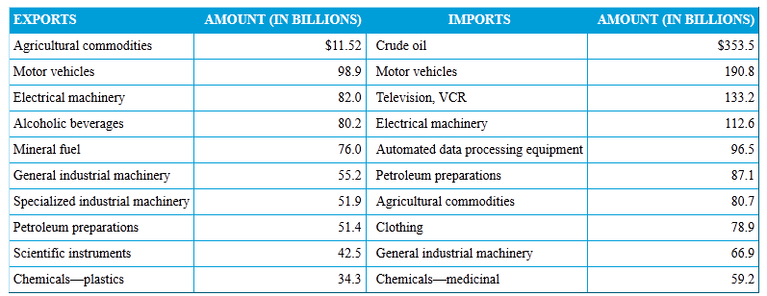
Major U.S. Exports and Imports
The U.S. demand for imported goods is partly a reflection of the nation’s prosperity and diversity.
The U.S. imports more goods than it exports, but exports more services than it imports.
Notes:
US Agri exports: Soybeans, course grains (corn), red meat, wheat, fruit’
Soybeans/oilseeds:US is largest producer and exporter
Corn: approx 11% of US corn production is exported (Japan, Mexico, Korea) Largest corn exporter (39%).
Wheat: US is largest exporter (Mexico, Japan, Nigeria) and 3rd largest producer behind China and India. 42% of US wheat is exported
Motor vehicle exports: “light” vehicles (pick up trucks, SUV’s)

Slide 13
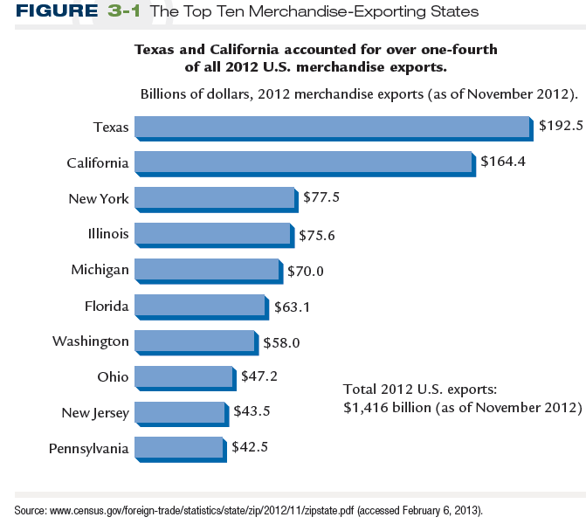
Exports by State
Notes:
Texas: Oil & Petro products (19%), Natural Gas (5%), Data Processing Mach (15%), Vehicle & Parts (5%)
California: Almonds (3%), Wine (1%), Aircraft, Vehicles, Machinery, Health Care, Electronics, Oil
New York: Diamonds (16%), Paintings, Jewelry, Gold, Original Sculptures, Civilian Aircraft & Parts, Rubies, Vaccines, Antiques, Perfumes, Electronics
Illinois: Petro products (5.5%), Soybeans (4%), Corn (1%), Medication, Electronics, Food products, Uranium (0.6%)
Michigan: Motor Vehicles & Parts (45%), Nuts & Bolts, Natural Gas (1.3%), Civilian Aircraft (1.3%),

Slide 14
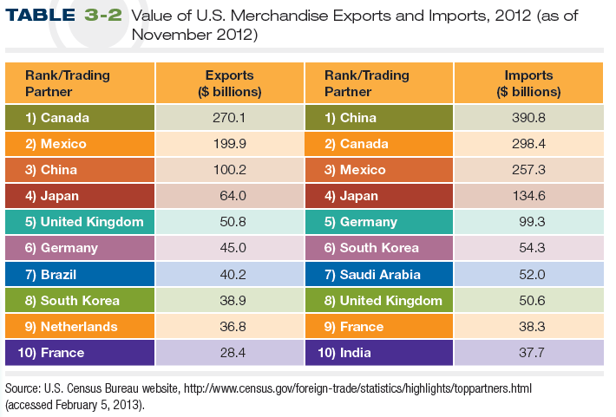
Largest Trading Partners for U.S.
Top Trading Partners

Slide 15
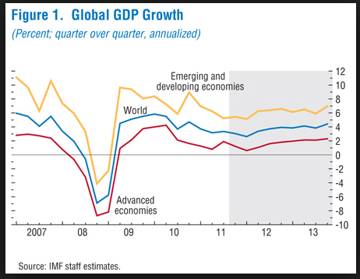
Size of the International Marketplace

Slide 16
Determining Trading Partners
Population Size vs. Prosperity
Though developing nations generally have lower per capita income, many have strong GDP growth rates and their huge populations can be lucrative markets.
Nation | Population | Per Capita GDP (US Dollars) | GDP Growth Rate
China | 1,355,692,576 | $ 9,800 | 7.7%
India | 1,236,344,631 | $ 4,000 | 3.2%
European Union | 511,434,812 | $34,500 | 0.1%
United States | 318,892,103 | $52,800 | 1.6%
Indonesia | 253,609,643 | $ 5,200 | 5.3%
Brazil | 202,656,788 | $12,100 | 2.3%
Ethiopia | 99,465,819 | $ 1,600 | 10.3%
Luxembourg | 570,252 | $ 97,600 | 5.6%
BUSN Exhibit 3.1
CIA World Factbook

Slide 17
International Sources of Factors of Production
Decisions to operate abroad depend upon availability, price, and quality of:
  Labor (Human Resources)
  Natural Resources
  Capital
  Entrepreneurship
Companies can spread risk throughout nations

Slide 18
Exporting and Importing
U.S. Exports
Excess Corn
Excess Wine
U.S. Imports
Countries trade when they each have a surplus of the product in which they specialize and want a product in which the other country specializes.
Notes:
18

Slide 19






Absolute Advantage
Absolute Advantage is the ability to produce a specific product more efficiently than any other nation.
  A country can produce more of a good than other nations, using the same amount of resources
Saudi Arabia – Crude Oil
South Africa - Diamonds
Australia - Wool
© ILDOGESTO/SHUTTERSTOCK
© DVARG/SHUTTERSTOCK
© AKAISER/SHUTTERSTOCK
© ILEYSEN/SHUTTERSTOCK
Notes:
Additional Resources
Video explaining Absolute and Comparative Advantage using Gilligan's Island example from From Here to Economy by Todd Buchholz: http://www.youtube.com/watch?v=38hvvAzgXZY

Slide 20
Comparative Advantage
Comparative Advantage is the ability to produce a specific product more efficiently than any other product.
  A country tends to turn out those goods that have the lowest opportunity cost compared to other countries
Country A
Country B
Country B has absolute advantage in both products, but a comparative advantage in motorcycles because it is relatively better at producing them.
Country B is 3 times better at motorcycles, but only 1.5 times better at cars.
Maximum Outputs
Automobiles
30m
45m
Motorcycles
6m
18m
Video: Absolute & Comparative Advantage Explained
Notes:
Example adapted from http://www.economicsonline.co.uk/Global_economics/Comparative_advantage.html

Slide 21
Competitive Advantage
Opportunity cost: Opportunity of giving up the second-best choice when making a decision
  Has a direct relation to international trade
A country has an absolute advantage when it can produce more of a good than other nations, using the same amount of resources
Comparative advantage: Benefit a country has in a given industry if it can make products at a lower opportunity cost than other countries

Slide 22
U.S. Trade in Goods
The U.S. imports more goods than it exports
(Billions of Dollars)
www.census.gov

Slide 23
U.S. Trade in Services
The U.S. exports more services than it imports
(Billions of Dollars)
www.census.gov

Slide 24
Balance of Trade
Balance of trade is the total value of a nation's exports minus the total value of its imports over some period of time.
Imports
Exports

Slide 25
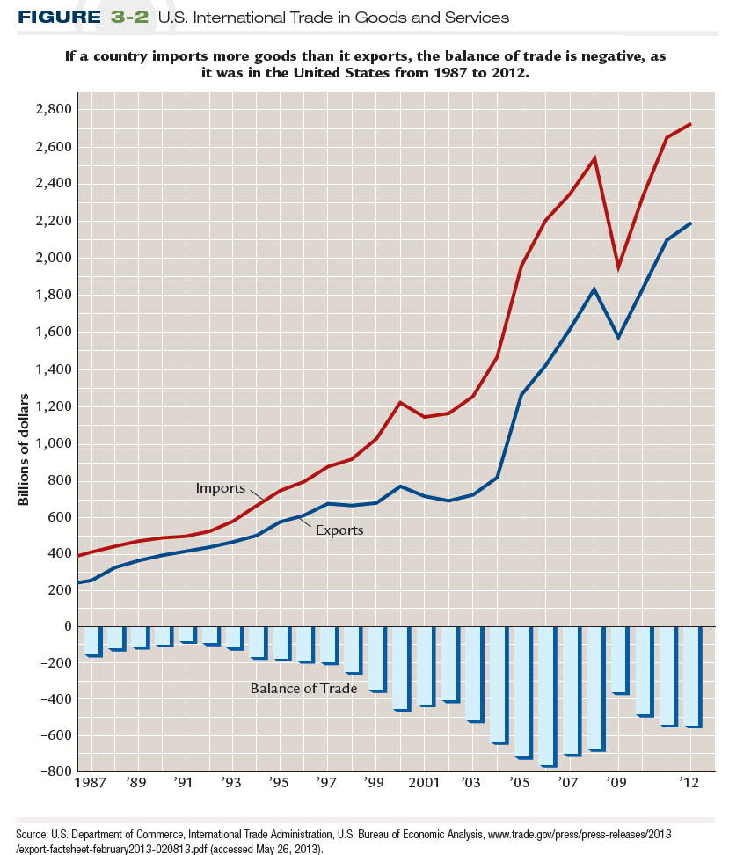
U.S. International Trade in Goods and Services

Slide 26
U.S. International Trade in Goods and Services

Slide 27
Trade Deficit
Trade deficit is a negative (unfavorable) balance of trade where imports exceed exports in value.
Imports
Exports

Slide 28
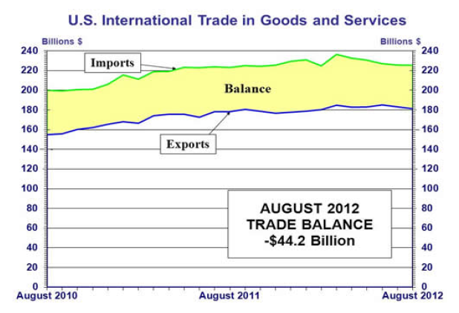
US International Trade Deficit
Source: https://www.bea.gov/newsreleases/international/trade/2017/pdf/trad1017.pdf
U.S. Historic Trade Balance & Balance of Payments (1960-2014)
Notes:
Source: http://www.bea.gov/newsreleases/international/trade/2012/pdf/trad0812.pdf

Slide 29
Balance of Payments
Balance of Trade: The total value of a nation's exports minus the total value of its imports over some period of time.
Balance of Payments: The total flow of money into or out of a country.
  Exports minus Imports
  Foreign borrowing and lending
  Foreign aid payments and receipts
  Foreign investments

